Slide 1
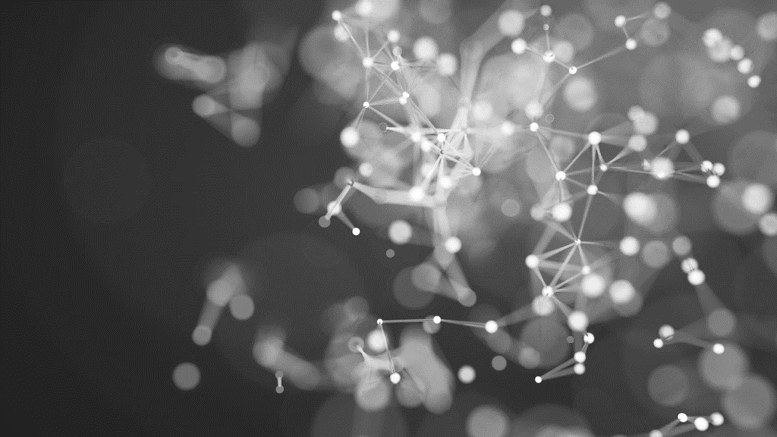
Hand written model Using GAN
DONE BY:
Gifta Grace. V BTECH/IT 3RD year
210921205015
graceblue0102@gmail.com
Loyola institute of technology
Palanchur,Chennai-123

Slide 2
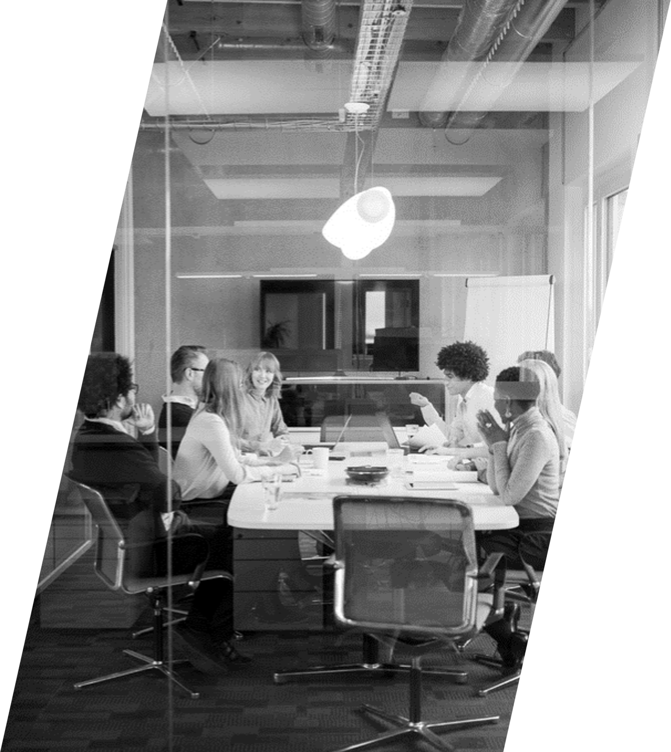
Outline
Problem Statement
Proposed System/Solution
System Development Approach
Algorithm and Deployment
Result
Conclusion
References

Slide 3
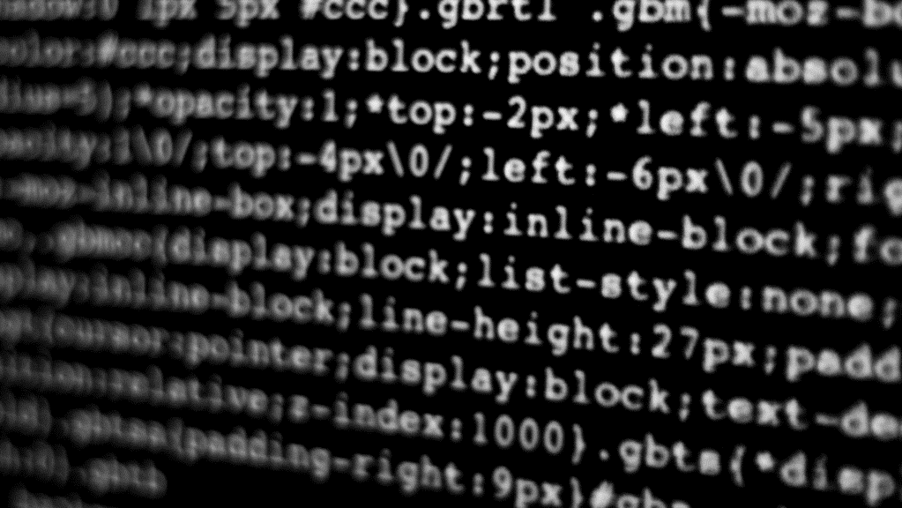
Problem Statement
Develop a Generative Adversarial Network (GAN) model to convert handwritten images of digits (0-9) into a clear, standardized digital format. The model should be able to generate high-quality, legible digits that closely resemble human handwriting, enhancing the accuracy and readability of handwritten text.

Slide 4

Proposed system
This system aims to develop a Generative Adversarial Network (GAN) for converting handwritten images of digits into a clear, standardized digital format. The process involves collecting a dataset of handwritten digit images and preprocessing them to standardize size, resolution, and orientation. The GAN architecture consists of a generator network that takes random noise as input and produces synthetic digit images, and a discriminator network that distinguishes between real and synthetic images. These networks are trained in an adversarial manner, where the generator learns to produce realistic images to fool the discriminator. Binary cross-entropy loss functions are used for training, and the model is evaluated based on image quality metrics such as clarity and resemblance to human handwriting. Once trained, the GAN can be deployed to enhance the accuracy and readability of handwritten text in applications like optical character recognition (OCR). Future work may involve further improving the GAN architecture for better image generation.

Slide 5

Proposed solution
Problem solution:
Introduce the problem of handwritten text recognition, highlighting challenges such as variability in handwriting styles and limited annotated data.
2.Data Collection and Preprocessing:
Collect a dataset of handwritten digit images (0-9), such as the MNIST dataset. Preprocess the Images to standardize the size, resolution and orientation.
3. Generator Network:
Design a generator network using a convolutional neural network (CNN) architecture.
Input: Random noise vector.
Output: Synthetic images of handwritten digits.
Use techniques like upsampling, batch normalization, and activation functions (e.g., ReLU) to generate realistic images.

Slide 6
Proposed solution
4.Discriminator Network:
Design a discriminator network using a CNN architecture. Input: Real or synthetic images of handwritten digits. Output: Probability score indicating the likelihood of the input image being real.
Use techniques like convolution, pooling, and activation functions (e.g., Leaky ReLU) to classify images as real or synthetic.
5. GAN Training Process:
Train the generator and discriminator networks in an adversarial manner. Initially, the generator produces random images, and the discriminator is trained to distinguish between real and synthetic images. The generator is trained to fool the discriminator by generating realistic images that are classified as real.

Slide 7
Proposed solution
6.Loss Functions
Use binary cross-entropy loss for both the generator and discriminator. Minimize the generator loss while maximizing the discriminator loss, creating a competitive training process.
7.Evaluation and Validation:
Evaluate the trained GAN on a separate validation dataset to assess the quality of generated images. Measure metrics such as image clarity, legibility, and resemblance to human handwriting.

Slide 8
Proposed solution
8.Deployment:
Deploy the trained GAN as a service or integrate it into a larger handwriting recognition system. Use the generated images to enhance the accuracy and readability of handwritten text in applications such as optical character recognition (OCR).
9.Benefits and Applications:
Highlight the benefits of using GANs for generating synthetic handwritten data, including improved model generalization, reduced data annotation costs, and enhanced performance in applications such as document digitization and signature verification.

Slide 9
Hardware requirements
System development approach
GPU from GeForce or Quadro series for deep learning tasks.
VRAM of 8GB to 16GB to store the model.
A modern multi-core CPU, such as an Intel Core i7 or AMD Ryzen.
A minimum of 16GB of RAM is recommended for training GANs.
A fast SSD is recommended for storing the dataset, model checkpoints, and other training-releated files.
Software requirements
Deep Learning frameworks that supports GANs, such as TensorFlow, PyTorch or Keras.
Python programming language due to its simplicity and availability of deep learning libraries.
CUDA and cuDNN to accelerate computations on the GPU.
OpenCV or PIL for image manipulation and processing.
An IDE such as PyCharm, Jupyter Notebook or Visual Studio Code for developing and running GAN model.
Additional libraries depending of you GAN model.
Version Contol software like Git can help you manage your project codebase, track changes and collaborate with others.
Virtual Environments such as virtualenv or conda to manage dependencies and ensure reproducibility of your experiments.

Slide 10
Algorithms
1. GAN Algorithm:
The GAN algorithm itself consists of two neural networks, the generator and the discriminator, which are trained simultaneously in a minimax game framework. The generator learns to generate realistic images to fool the discriminator, while the discriminator learns to distinguish between real and generated images.
2. Binary Cross-Entropy Loss:
This loss function is typically used for training both the generator and discriminator in GANs. It measures the difference between the predicted probability distribution (output) and the actual distribution (real or fake).
3. Convolutional Neural Networks (CNNs):
CNNs are commonly used as the building blocks for both the generator and discriminator networks in GANs for image-related tasks. CNNs are well-suited for capturing spatial patterns in images.
4. Stochastic Gradient Descent (SGD) or Adam Optimizer:
These are common optimization algorithms used to update the weights of the neural networks during training. Adam optimizer is often preferred for its adaptive learning rate properties.

Slide 11
Algorithms
5. Batch Normalization:
Batch normalization is a technique used to improve the training of deep neural networks by normalizing the inputs of each layer. It helps to stabilize and speed up the training process.
6. Leaky ReLU Activation Function:
Leaky ReLU is a variant of the rectified linear unit (ReLU) activation function that allows a small, non-zero gradient when the input is negative. This helps prevent the issue of "dying ReLU" and can improve the training of GANs.

Slide 12
Deployment
1.Model Training: Train your GAN model using a dataset of handwritten digits, such as MNIST or SVHN dataset. The GAN should be able to generate clear, standardized digit images from noisy or handwritten inputs.
2.Model Evaluation: Evaluate the trained model to ensure it performs well on the task of converting handwritten images into clear, standardized digital format. Use metrics such as accuracy, precision, recall, and F1-score to evaluate the model's performance.
3. Model Deployment: Once you have a trained and evaluated model, you can deploy it using various deployment strategies, such as:
Server Deployment: Deploy the model on a server using frameworks like TensorFlow Serving, Flask, or Django. This allows you to create a REST API that can be accessed by client applications to convert handwritten images into digital format.
Cloud Deployment: Deploy the model on cloud platforms like AWS, Azure, or Google Cloud Platform (GCP). These platforms provide services for deploying machine learning models, such as AWS SageMaker, Azure ML, or Google Cloud AI Platform.

Slide 13
Deployment
4.Client Application: Develop a client application (web, mobile, or desktop) that allows users to upload handwritten images and receive clear, standardized digital format outputs. The client application will interact with the deployed model using the API or cloud service.
5.Testing and Monitoring: Test the deployed model to ensure it performs as expected in a production environment. Monitor the model's performance and usage to identify any issues and make improvements as needed.
6. Maintenance and Update: Regularly maintain and update the deployed model to improve its performance, security, and reliability. This may involve retraining the model with new data or updating the deployment infrastructure.

Slide 14
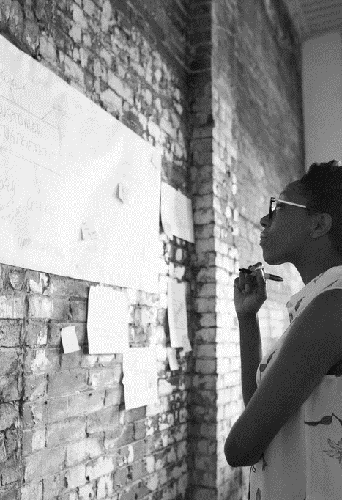
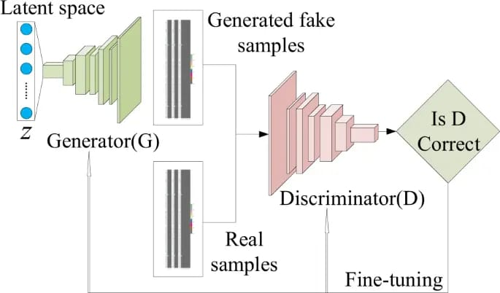
Result

Slide 15
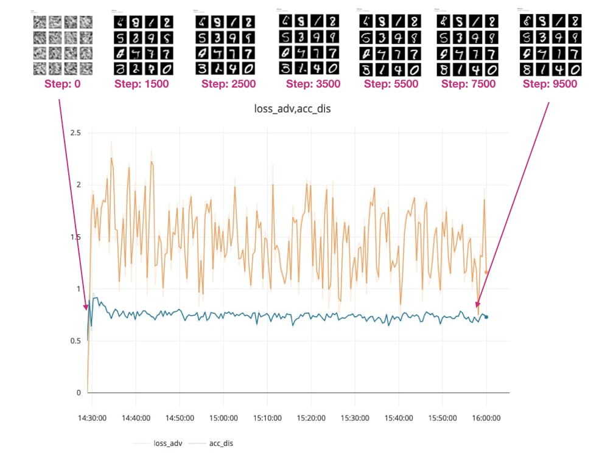
Result

Slide 16
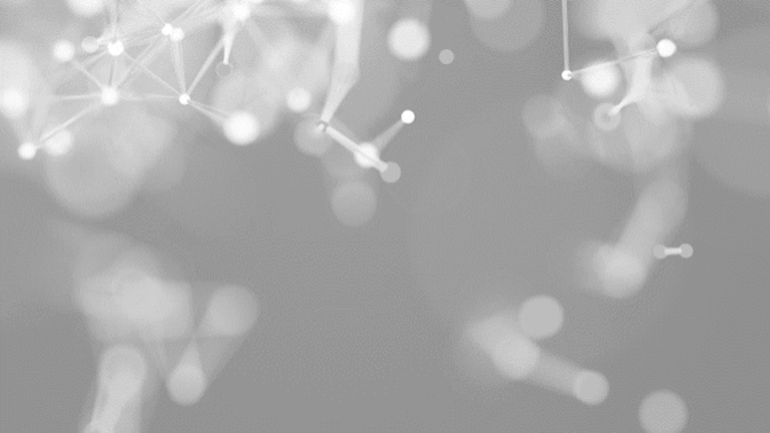
conclusion
In conclusion, developing and deploying a Generative Adversarial Network (GAN) model for converting handwritten images of digits into a clear, standardized digital format is a challenging but rewarding endeavor. The GAN architecture, with its ability to generate realistic and high-quality images, can be a powerful tool for enhancing the digitization of handwritten content.Throughout the development process, key considerations such as dataset selection, model architecture, training strategies, and evaluation metrics play a crucial role in the success of the model. Additionally, deploying the model involves careful planning to ensure its performance, scalability, and reliability in a production environment.By leveraging the capabilities of GANs and implementing effective deployment strategies, this model can significantly improve the efficiency and accuracy of converting handwritten digits into digital format, benefiting various applications such as optical character recognition (OCR), document digitization, and data analysis.

Slide 17
References
"Improved Techniques for Training GANs" by Tim Salimans, Ian Goodfellow, et al.
"Conditional Generative Adversarial Nets" by Mehdi Mirza and Simon Osindero
"Semi-supervised Learning with Generative Adversarial Networks" by Alec Radford, Luke Metz, Soumith Chintala
"Generating Handwritten Text Images" by Xinyu Zhou, Song Han, et al.
"Learning What and Where to Draw" by Scott Reed, Zeynep Akata, et al.
“Generative adversarial nets” by Goodfellow, Ian, et al.

